Slide 1

Graph Algorithms
Ahmedur Rahman Shovon
PhD (Student), CS
UAB

Slide 2

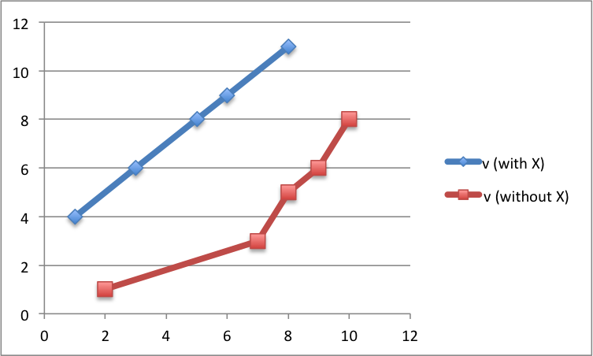
Graph in Mathematics or in normal use

Slide 3
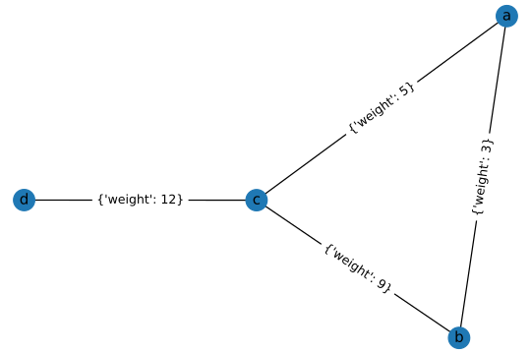
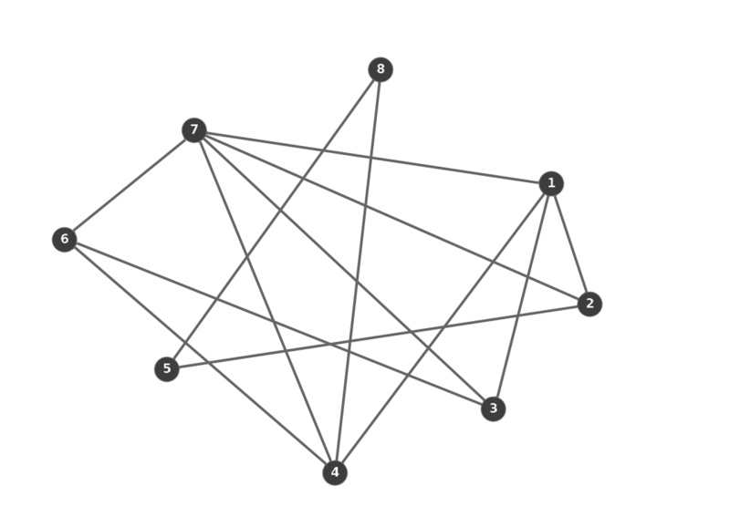
What about graph in Algorithm?

Slide 4
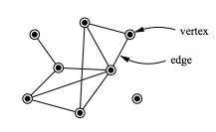
Components of a graph
Vertices / Nodes:
Represented as set of vertices
V = {P, Q, R, S}
Edges:
Represented as set of connection between vertices
E = {{P, Q}, {Q, S}, {SR}}
Graph:
Represented as the combination of vertices and edges
G = (V, E)
R
Q
P
S

Slide 5
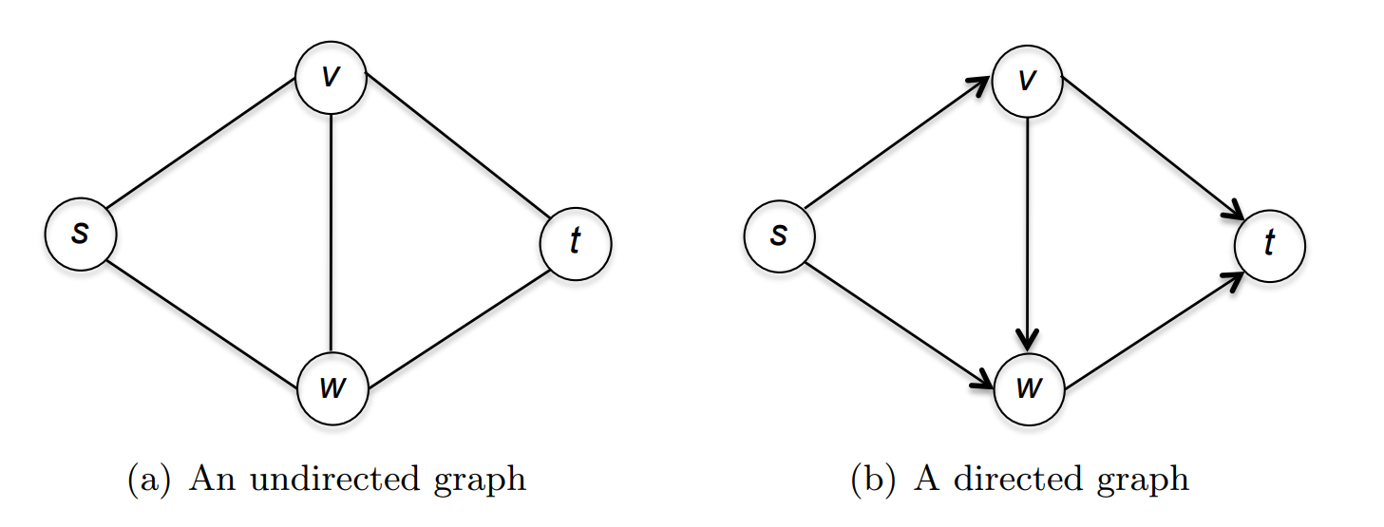
Types of Graphs
V = {s, v, t, w}
E = {{s, v}, {v, t}, {t, w}, {v, w}, {w, s}}
E contains Unsorted order of vertices
V = {s, v, t, w}
E = {(s, v), (s, w), (v, w), (v, t), (w, t)}
E contains Sorted order of vertices

Slide 6
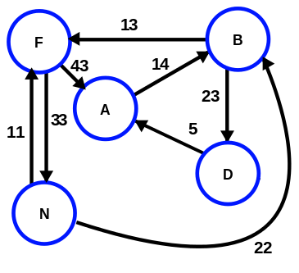
Weighted Graph
Directed and undirected graph can have weight between vertices
The weight is also known as distance

Slide 7


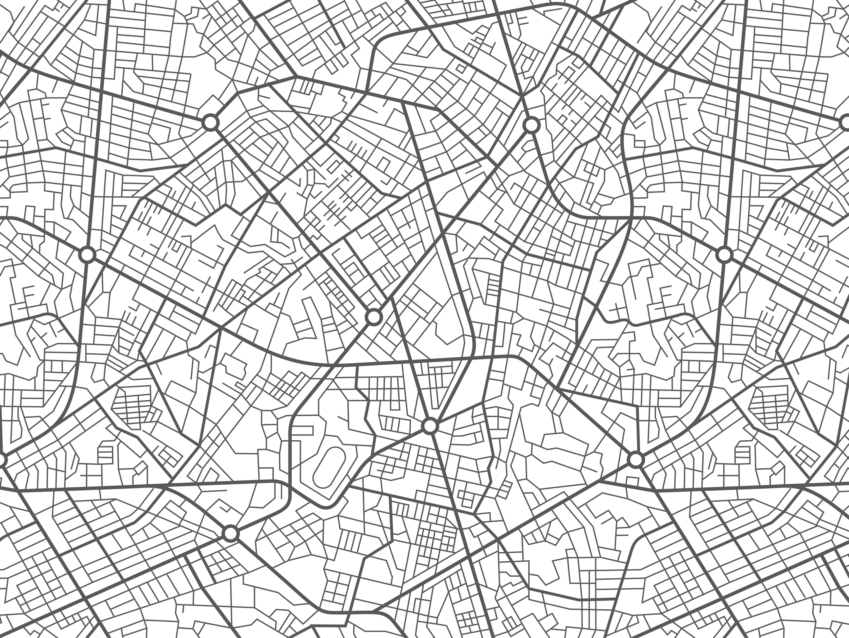
Applications of Graph
Road networks, navigation
The World Wide Web
Social Networks
Puzzle solving
Notes:
(You can solve a 2 x 2 Rubik's cube using today's class)

Slide 8
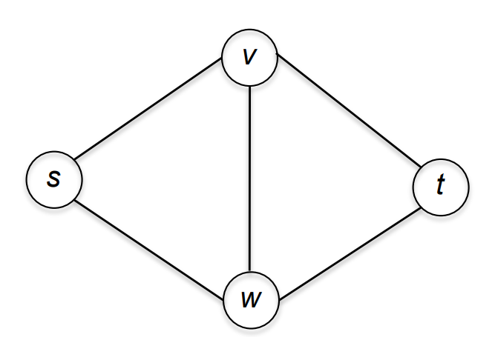
Notation for Graphs
For a graph G = (V, E) with vertex set V and edge set E:
n = |V| denotes the number of vertices.
m = |E| denotes the number of edges.
In the figure,
n = number of vertices = 4
m = number of edges = 5

Slide 9
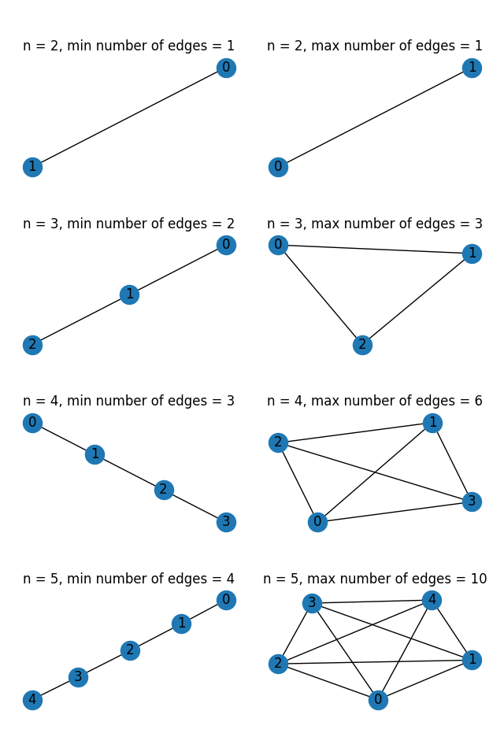
Minimum & Maximum number of Edges
Assume the following properties:
The graph is undirected
The graph is connected
There are no parallel edges between vertices

Slide 10
Quick Quiz
For an undirected connected graph with n vertices and no parallel edge, what are the minimum and maximum numbers of edges?
Minimum number of edges = n – 1, maximum number of edges = (n * (n - 1)) / 2
Minimum number of edges = n – 1, maximum number of edges = n²
Minimum number of edges = n, maximum number of edges = 2^{n}
Minimum number of edges = n – 1, maximum number of edges = n^{n}

Slide 11
Quiz Solution
For an undirected connected graph with n vertices and no parallel edge, what are the minimum and maximum numbers of edges?
Minimum number of edges = n – 1, maximum number of edges = (n * (n - 1)) / 2
A connected graph with the minimum number of edges (n-1 edges) is called a Tree.
A connected graph with maximum number of edges ((n * (n - 1)) / 2 edges) is known as Complete Graph

Slide 12
Sparse and Dense Graphs
A graph is Sparse if the number of edges is relatively close to linear in the number of vertices.
| E | ≅ n
A graph is Dense if the number of edges is relatively close to quadratic in the number of vertices.
| E | ≅ n²
Graph representation may vary for Sparse and Dense graphs

Slide 13
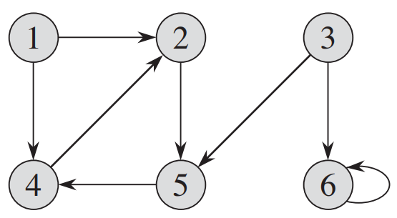
In-degree and out-degree
In a directed graph,
The in-degree of a vertex is the total number of incoming edges
The out-degree of a vertex is the total number of outgoing edges
In an undirected graph,
The degree of a vertex is the total number of adjacent nodes
The sum of degrees of all nodes is the double of number of edges of the graph
0/2
2/1
0/2
2/1
2/1
2/1

Slide 14
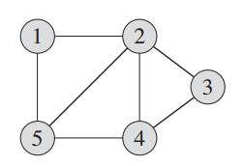
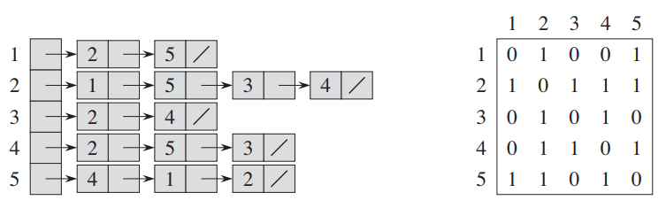
Graph Representation
Two standard ways to represent a graph G = (V, E) are:
Adjacency-list representation
Adjacency-matrix representation
Graph G = (V, E)
Adjacency-list representation of G
Adjacency-matrix representation of G

Slide 15
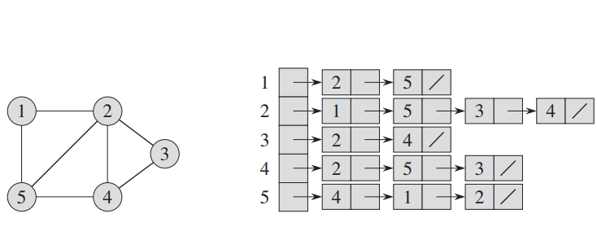
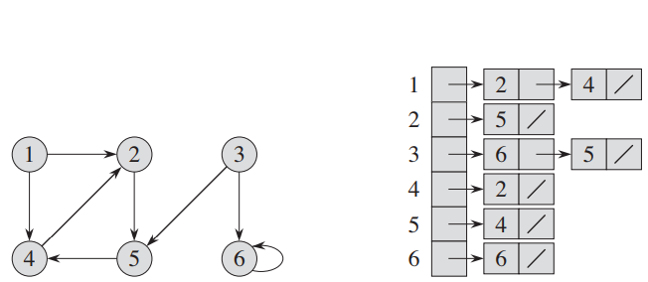
Adjacency-list representation
Adjacency-list representation of graph G = (V, E) consists of:
An array for each vertex, Adj of |V|
Each array index consists of a list of vertices which are connected to the vertex, Adj[u] contains the list of vertices which are connected to vertex u
Suitable for Sparse graphs
Adjacency-list for undirected graph
Adjacency-list for directed graph

Slide 16
Adjacency-list space requirement
Given a graph G with n vertices and m edges. What is the space requirement of adjacency-list representation of graph G?
Θ(n)
Θ(m)
Θ(n + m)
Θ(n²)
Adjacency-list for undirected graph
Space requirements
Θ(n + m)
Adjacency-list for directed graph

Slide 17
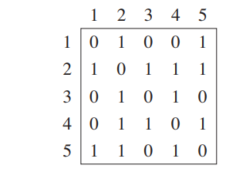
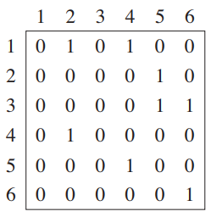
Adjacency-matrix representation
Adjacency-matrix representation of graph G = (V, E), n = |v| consists of:
A square matrix A of size n × n
Each entry A_{ij} is defined as: A_{ij} = 1, if edge(i, j) ∈ E A_{ij} = 0, otherwise
Suitable for Dense graphs
Adjacency-matrix for undirected graph
Adjacency-matrix for directed graph

Slide 18
Adjacency-matrix space requirement
Given a graph G with n vertices and m edges. What is the space requirement of adjacency-matrix representation of graph G?
Θ(n)
Θ(m)
Θ(n + m)
Θ(n²)
Adjacency-matrix for undirected graph
Space requirements
Θ(n²)
Adjacency-matrix for directed graph

Slide 19
Comparing the representations
For Sparse graphs (| E | ≅ n ) adjacency-list representation takes less space
For Dense graphs (| E | ≅ n² ) adjacency-matrix representation is faster
The representation should be selected based on the requirement
Graph G = (V, E)
Adjacency-list representation of G
Adjacency-matrix representation of G

Slide 20
Graph Search
For a graph G = (V, E) with vertex set V and edge set E, graph search refers to the process of visiting each vertex in a graph
Traversals are classified by the order in which the vertices are visited
Also known as Graph Traversal

Slide 21


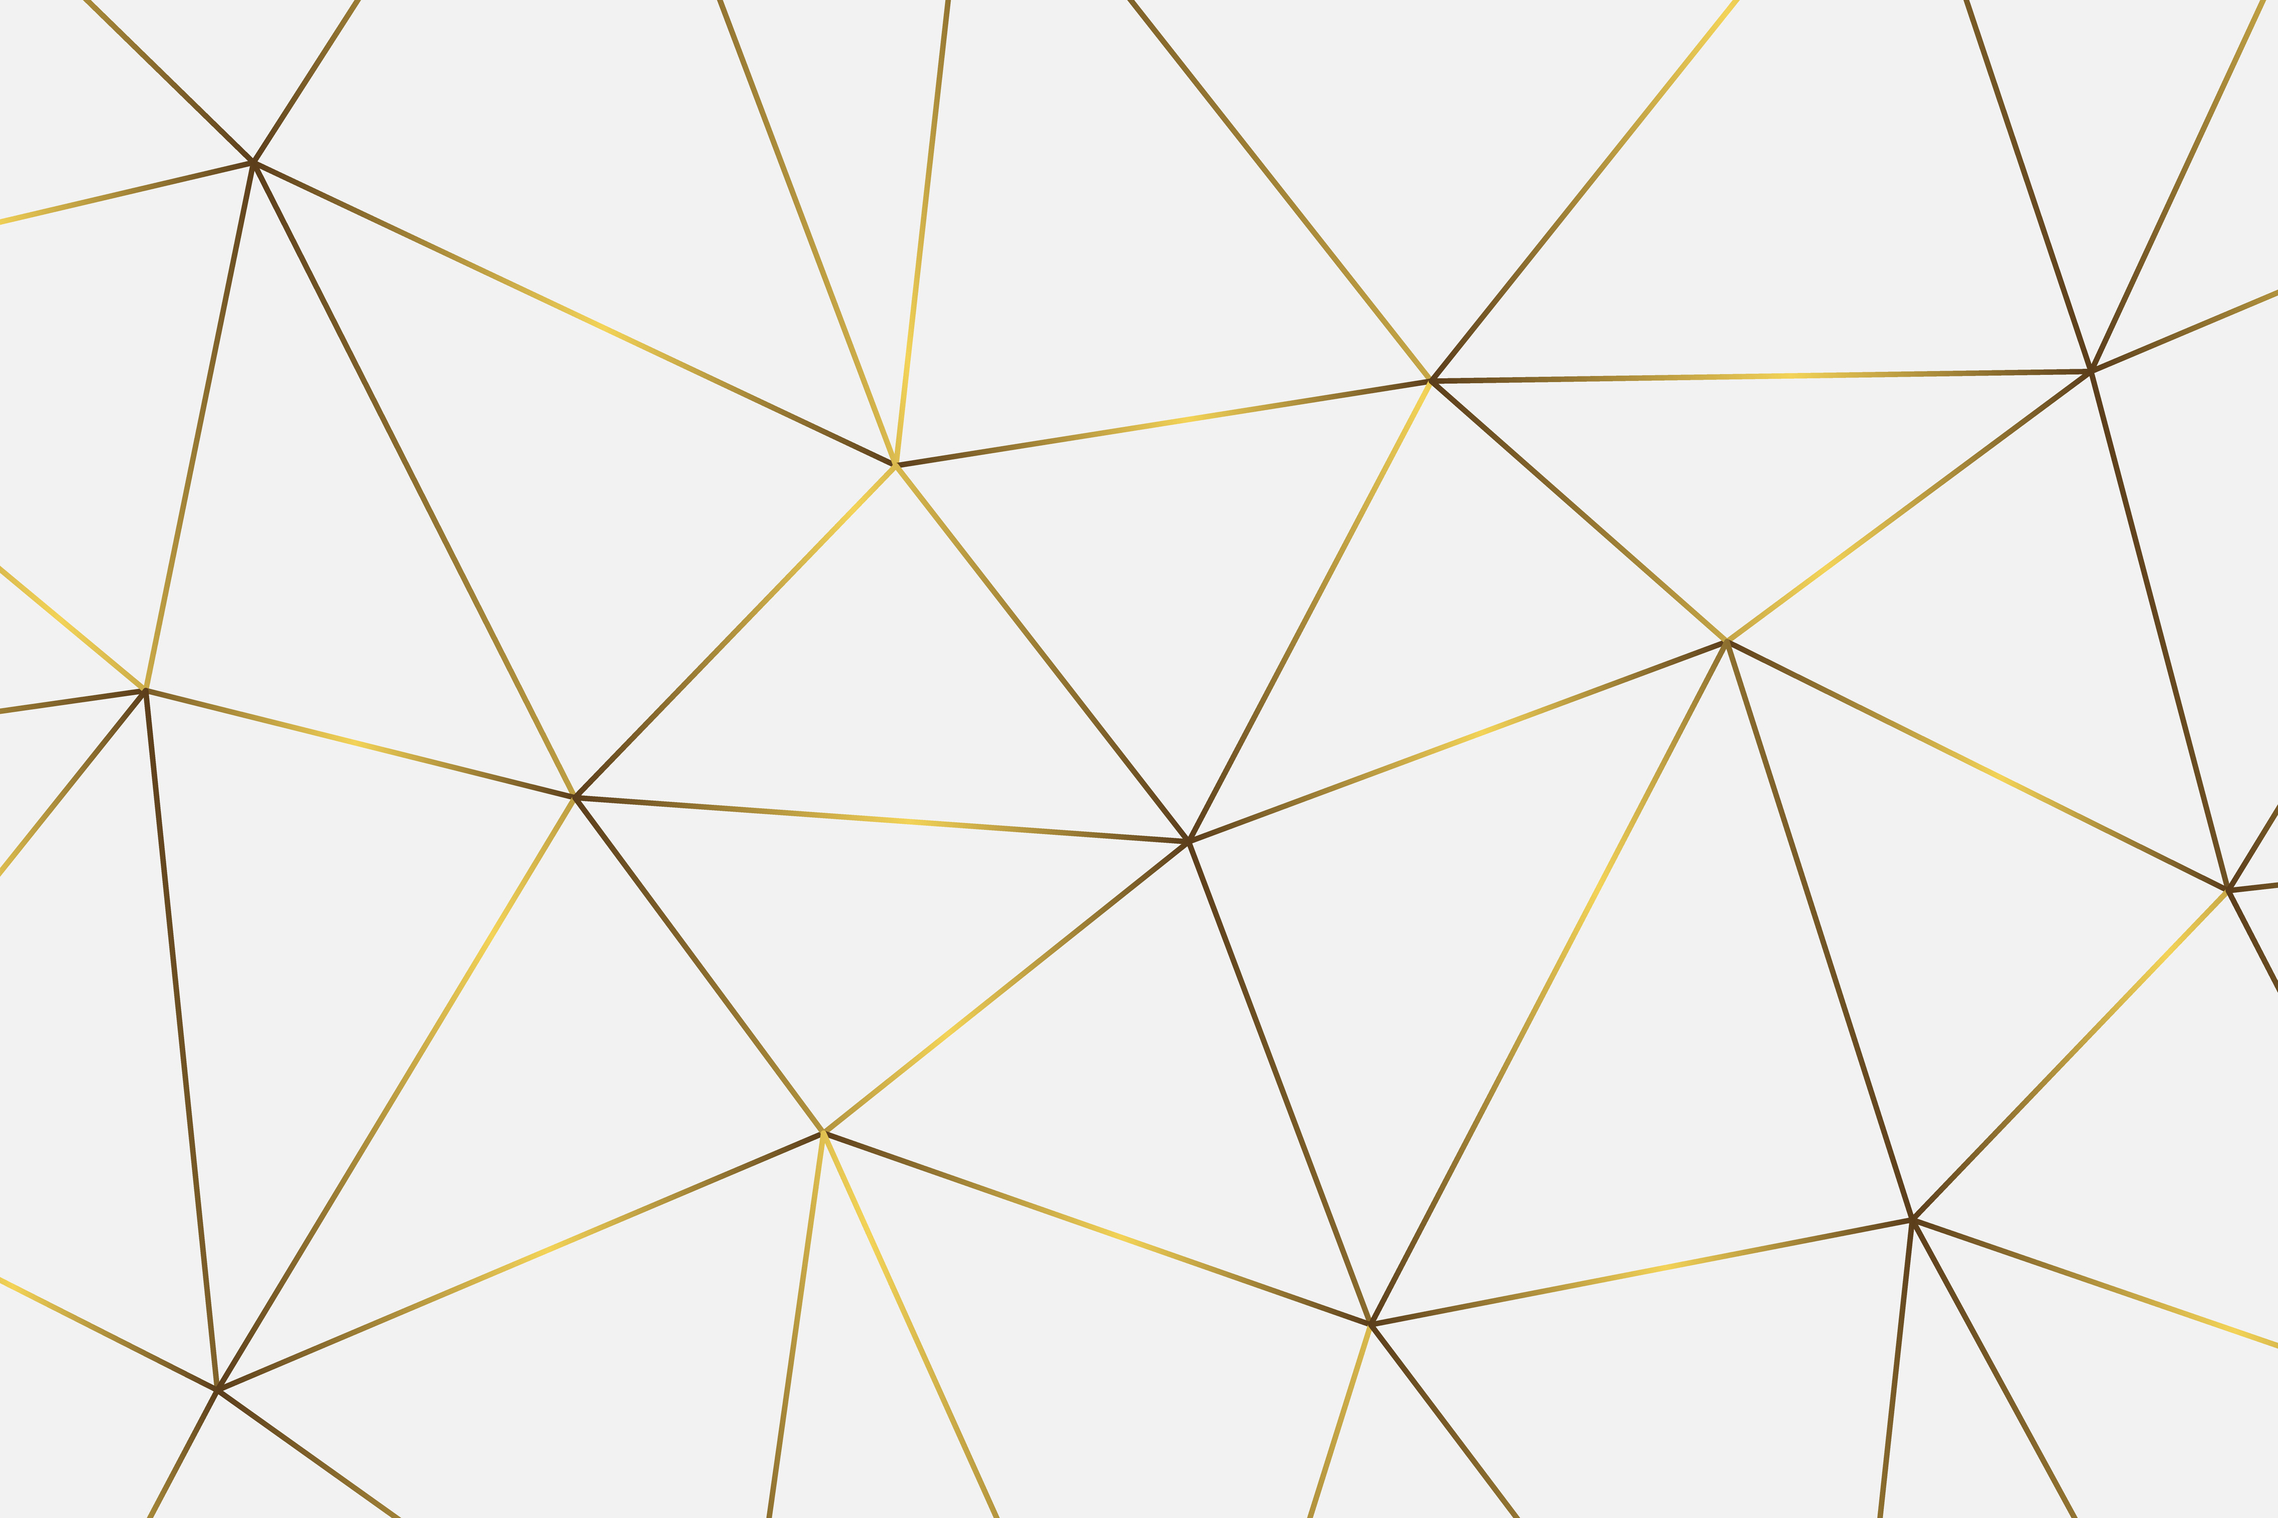
Applications of Graph Search
Checking connectivity
Shortest paths
Planning
Connected components
Notes:
Checking connectivity: What is the degree of connectivity
Planning: Solving puzzles in optimal way
Connected components: number of pieces / components in a graph

Slide 22
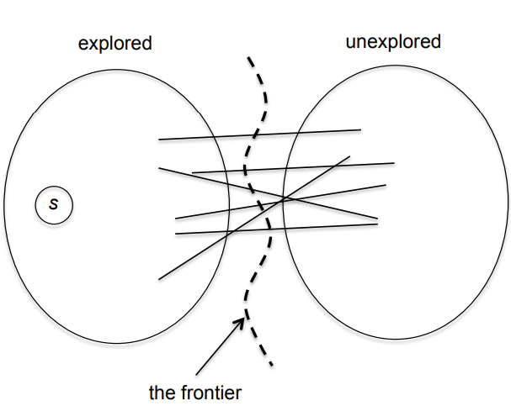
Breadth-first Search
Breadth-first search (BFS) is one of the simplest algorithms for graph traversal
BFS calculates the shortest path between two nodes
For a given graph, G = (V, E) and a source vertex s ∈ V BFS explores the edges of G to discover every vertex that is reachable from s
BFS works on both directed and undirected graphs
It expands the frontier between discovered and undiscovered vertices uniformly across the breadth of the frontier, so it is called Breadth-first search
It discovers all vertices at distance k from s before discovering any vertices at distance k + 1

Slide 23
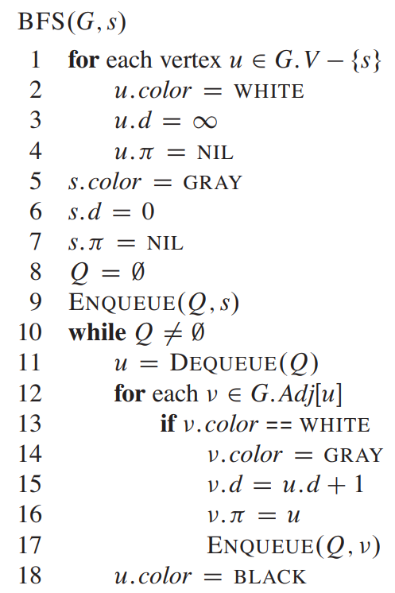
BFS Algorithm
Initially each of the vertex is configured as:
Color to WHITE
depth to infinity
parent as NIL
A queue is used to keep track of the traversal
If a vertex with WHITE color is discovered, it painted GRAY and added to the queue
If a vertex completes traversal, it painted BLACK
The traversal continues until the queue is empty
Running time: O(V + E)
BFS ensures to visit each node once only

Slide 24
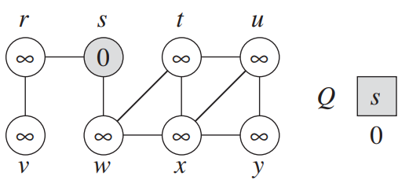
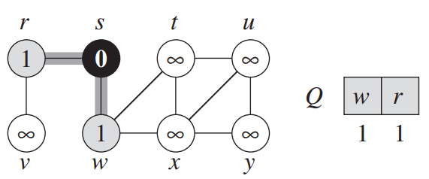
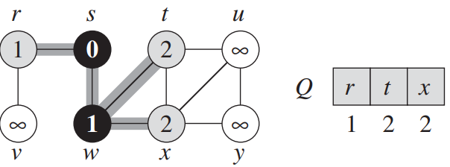
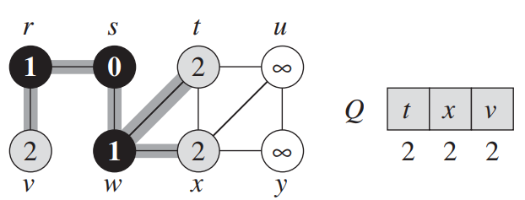
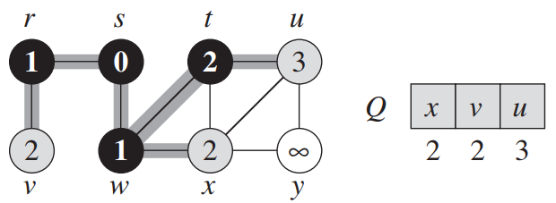
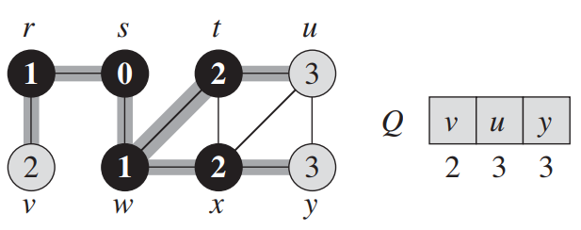
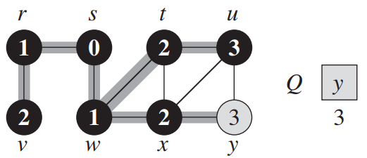
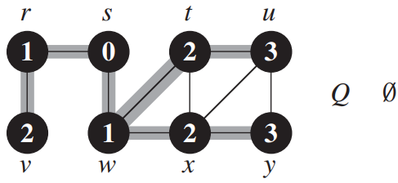
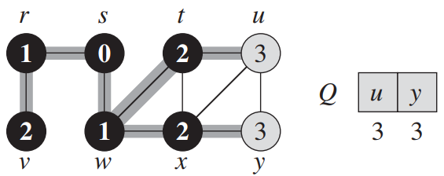

Slide 25

Challenge Solving Session Live
Challenge: https://practice.geeksforgeeks.org/problems/bfs-traversal-of-graph/1
Solution: https://gist.github.com/arsho/5a0e8670b328909b22b94069e157de5d

Slide 26
References
Rivest, R. L., Leiserson, C. E., Stein, C., Cormen, T. H. (2009). Introduction to Algorithms. United Kingdom: MIT Press.
Roughgarden, T. (2018). Algorithms Illuminated: Graph algorithms and data structures. Part 2. United States: Soundlikeyourself Publishing LLC.

Slide 27

THANK YOU

